Slide 1
Scaling up climate risk assessment indicators across regions Scalability workshop 30.09.2025
EARSC Christopher Oligschläger

Slide 2

Housekeeping Rules
Use your FULL NAME & ORGANISATION
MUTE YOUR MICROPHONE
Feel free to USE your CAMERA
Use the Chat for questions
Introduce yourself when you start speaking
The workshop will be recorded
Notes:
SeBS short case studies structure:
The challenge
How the VALORADA tools/indicators can help
Who is the primary user? What is the value chain (and the cascading effects)
What are the benefits? (SeBS Benefits assessment framework)
Extended impact (which other users could make use of the tools? Which other geographic markets could use the tool?)

Slide 3

About the Scalability Workshop Series
A series of workshops across Europe to:
Share real experiences from project demonstrator regions
Engage local and regional stakeholders
Explore how climate risk tools can be scaled and reused
Based on practical case studies, co-developed by users who applied the tools
Designed to foster peer learning, feedback and future collaboration

Slide 4



Why Are We Doing This?
Climate risks are local, but data and solutions can be shared
VALORADA provides actionable indicators for planning
Peer learning builds confidence in adopting new tools
Our goal: empower more regions to pursue data-driven climate adaptation

Slide 5
Today’s Agenda
Introduction to the project
How the indicators & tools were developed
Live demo of the VALORADA dashboard
Local user experience from Přerov and Mladá Boleslav
Interactive discussion & feedback
We invite you to ask, share and explore how the indicators and tools could support your own work.

Slide 6
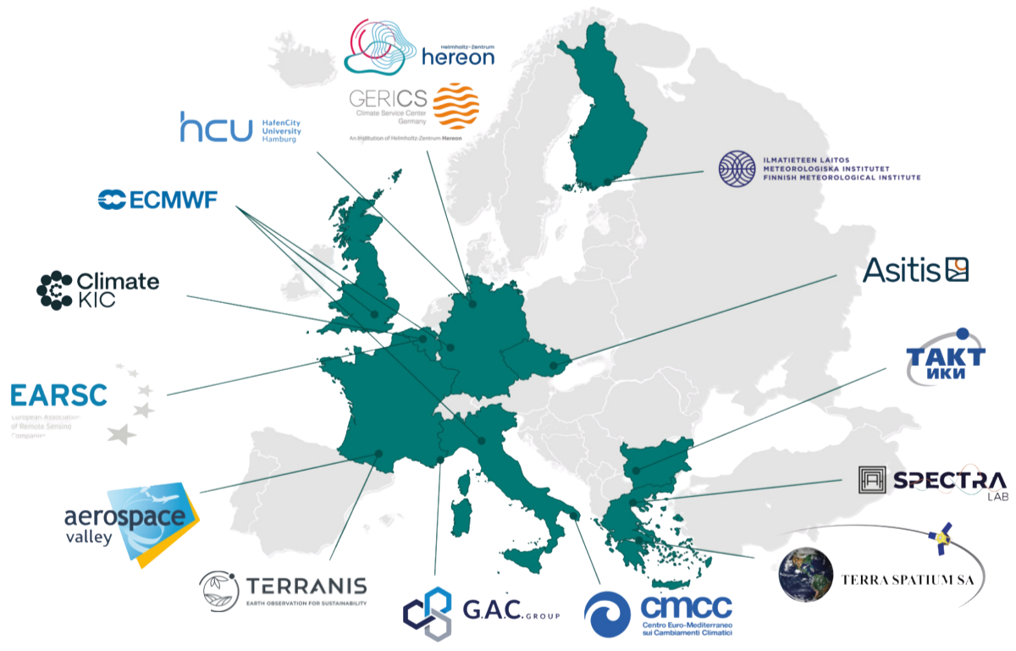
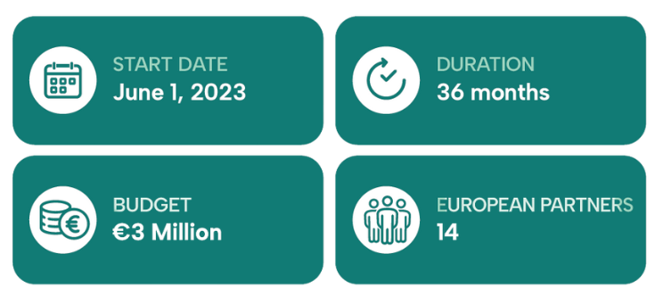
VALORADA at a glance
VALORADA is a project funded by the European Commission in the framework of the HORIZON EUROPE programme under Grant Agreement Number 101112837

Slide 7
VALORADA’s alignment with the EU’s Mission Adaptation
The goal of the VALORADA project is to empower European regions and cities to steer the upcoming societal transformation towards sustainable and climate-resilient development. VALORADA project is in line with the EU’s Adaptation Mission to transform 150 European regions into sustainable and climate-resilient regions by 2030 in order to:
Support European regions and communities to become climate resilient.
Accelerate societal transformations to climate resilience in European regions and communities.
Demonstrate systemic transformations to climate resilience in European regions and communities; improving access to and usability of available climate data for adaptation purposes is urgently needed.
1
2
3

Slide 8
Objectives
Assessing the data baseline for climate adaptation and climate resilience needed on a regional and local scale
1
2
Showcasing the added value of prototype data manipulation tools through demonstration activities and evaluation
Identifying the main risk factors to be prioritised in adaptation strategies
Identifying, describing and appraising accessibility, usability, customisation and adaptability of existing European climate and non-climate data and data portals with respect to user requirements at a regional level
Co-constructing a legitimised and operational framework of climate value associated with socioeconomic, demographic and Earth observation datasets
Co-developing and applying protocols and guidelines to generate “resilience-information catalogues” in each demonstrator
Identifying climate-risk indicators that provide contextualisation of vulnerability, exposure and adaptive capacity
Co-developing customizable data manipulation tools to support contextualising climate and non-climate data
3
Maximising the impact of VALORADA tools and applications following the FAIR principles
Facilitating interoperability of the VALORADA tools with existing climate-data repositories.
Providing capacity building across 5 demonstrators
Assessing the impact of VALORADA tools across Demonstrators
Maximising the local, regional and global visibility and impact of project activities and results

Slide 9


The 5 Demonstrators
VALORADA’s visionary framework is taking shape through five dynamic demonstrators, each focusing on different sectors, climate risks, and community systems.

Slide 10
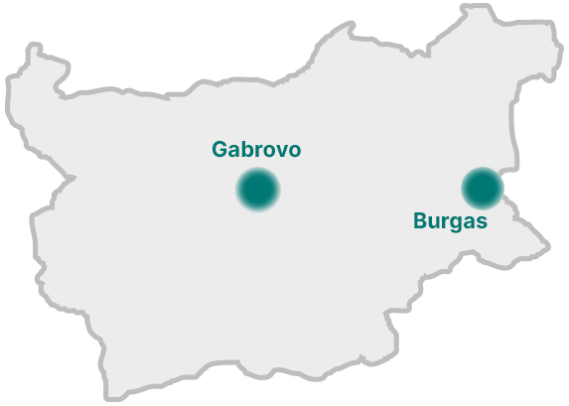

Demonstrator #1 Gabrovo & Burgas Municipalities, Bulgaria
VALORADA actions
Monitoring of flash floods
Monitoring on drought and forest fires, air quality monitoring and heat islands in urban areas
Looking at adaptation solutions for mostly urban environment
Monitoring of air quality, heat islands, wildfires, extreme rainfall, drought (Burgas)
Wetlands monitoring (Burgas)
Leading partner

Slide 11
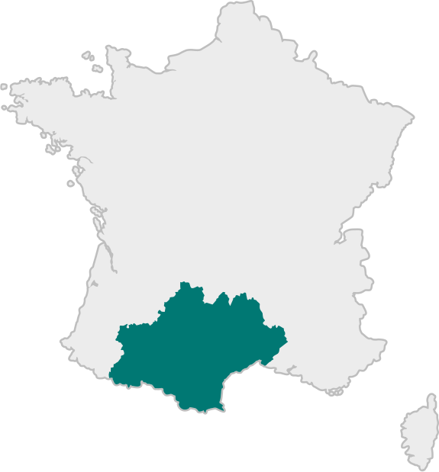

Demonstrator #2 Occitania region, France
VALORADA actions
Assessing risks for agriculture and viticulture during hot, water-scarce summers
Identifying urban heat islands and their impact on vulnerable populations, considering the benefits of more vegetation
Evaluating risks from rising Mediterranean coastal water levels on soil, water salinity, and local agriculture
Leading partner

Slide 12
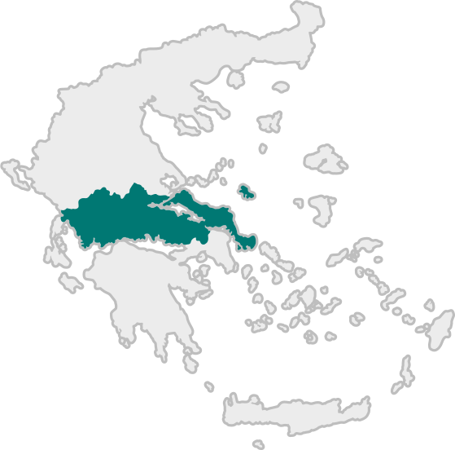


Demonstrator #3 Region of Central Greece
VALORADA actions
Evaluating the risks for the agriculture regional sector linked to hot summer periods, lack of water available for irrigation, soil erosion
Assessing the risks linked to water level increase in the Mediterranean coastal zone
Leading partner

Slide 13
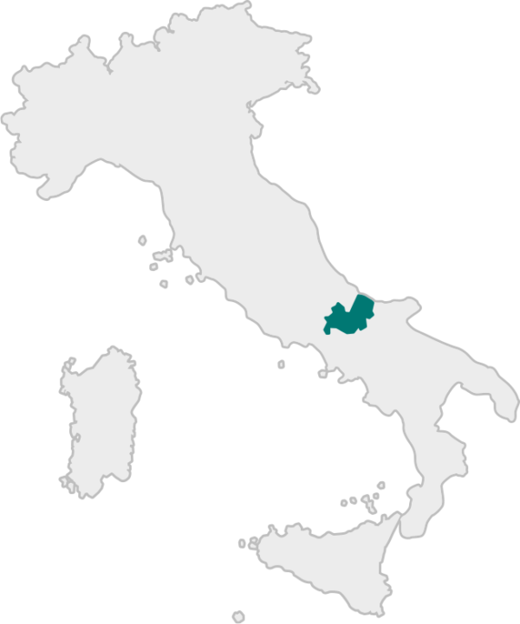

Demonstrator #4 Molise region, Italy
VALORADA actions
Evaluating the risks for the agriculture and livestock sector linked to climatic changes with a main focus on social vulnerability due to the aged population and evaluation of potential adaptation measures
Assessing the risks linked to water level increase and extreme events in the Adriatic coastal zone
Leading partner

Slide 14
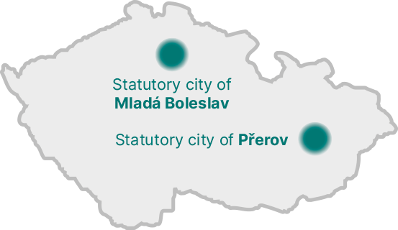

Demonstrator #5 Statutory cities of Přerov and Mladá Boleslav, Czechia
VALORADA actions
Determining the most vulnerable urban green areas as well as the key urban green infrastructure
Predicting the health state of the urban green functional areas in the future
Proposing additional nature-based solutions to enhance the city’s adaptation capacity, and thus its climate resilience
Leading partner

Slide 15

Mentimeter

Slide 16

Many thanks!
christopher.oligschlaeger@earsc.org
cristobal.reveco@hereon.de (Project coordinator)
vokral@asitis.cz (Technical partner)

